Slide 1
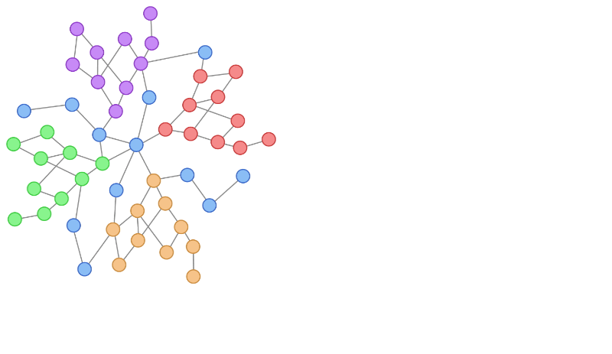

Social Project

Slide 2
Team Members
. 1- العمده سلطان عبد العزيز
. 2- سلام راضي رمضان
3- إبراهيم محمد على .
. 4- عبد الله احمد حمدى
. 5- محمود حمدى مرسي

Slide 3
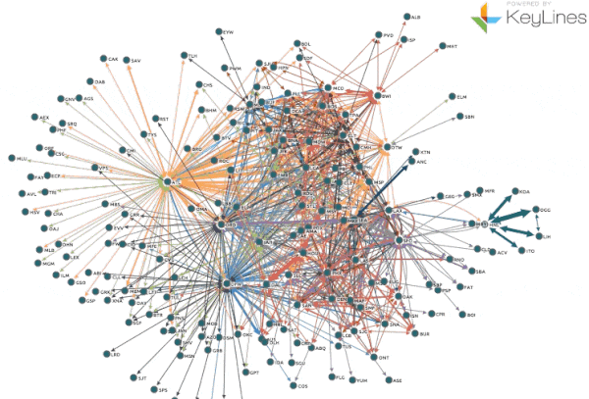




Dataset
1- Description :
A social friendship network extracted from Facebook consisting of people (nodes) with edges representing friendship ties.
2- Link :
https://networkrepository.com/socfb-Mich67.php

Slide 4
Draw Graph & Some Details

Slide 5
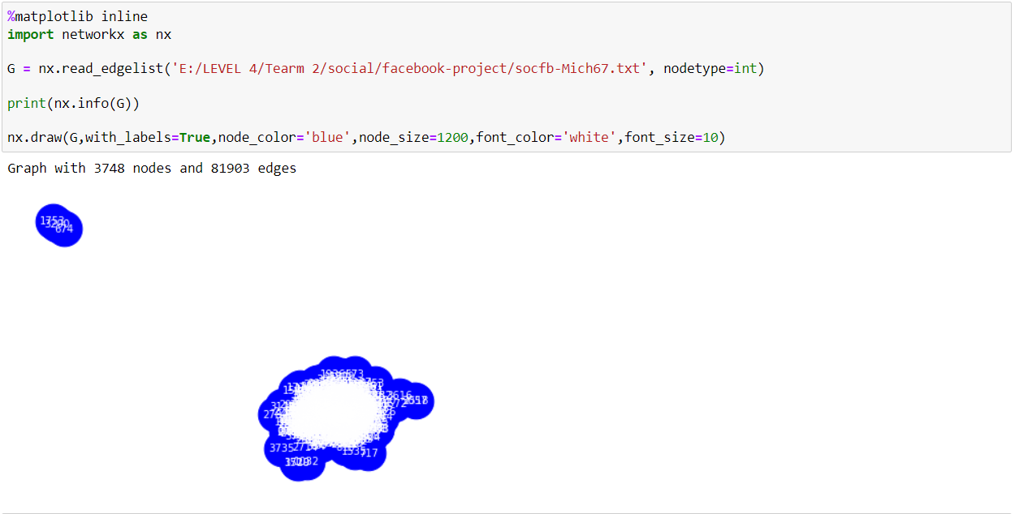
1-Read & Draw The Graph:

Slide 6
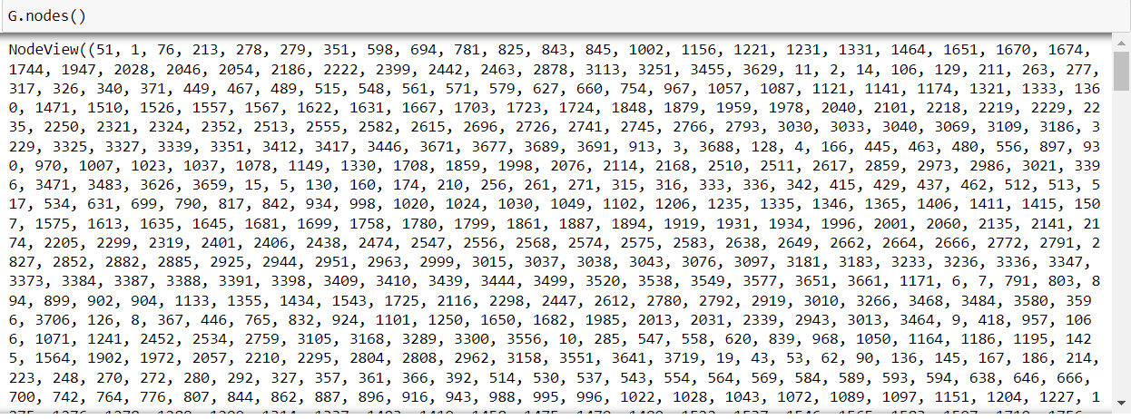
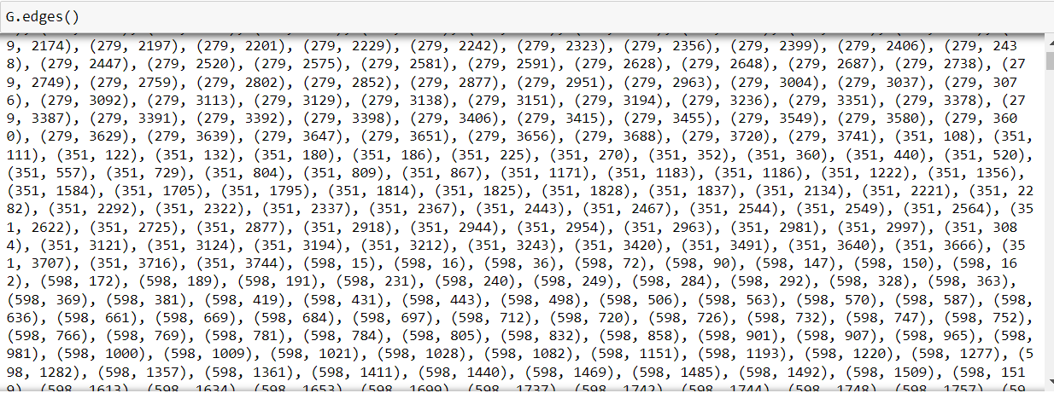
2-Nodes & Edges

Slide 7
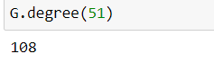
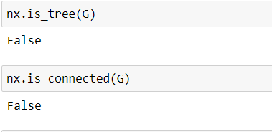
3-Example of degree of a node. 4-tree & connected.

Slide 8
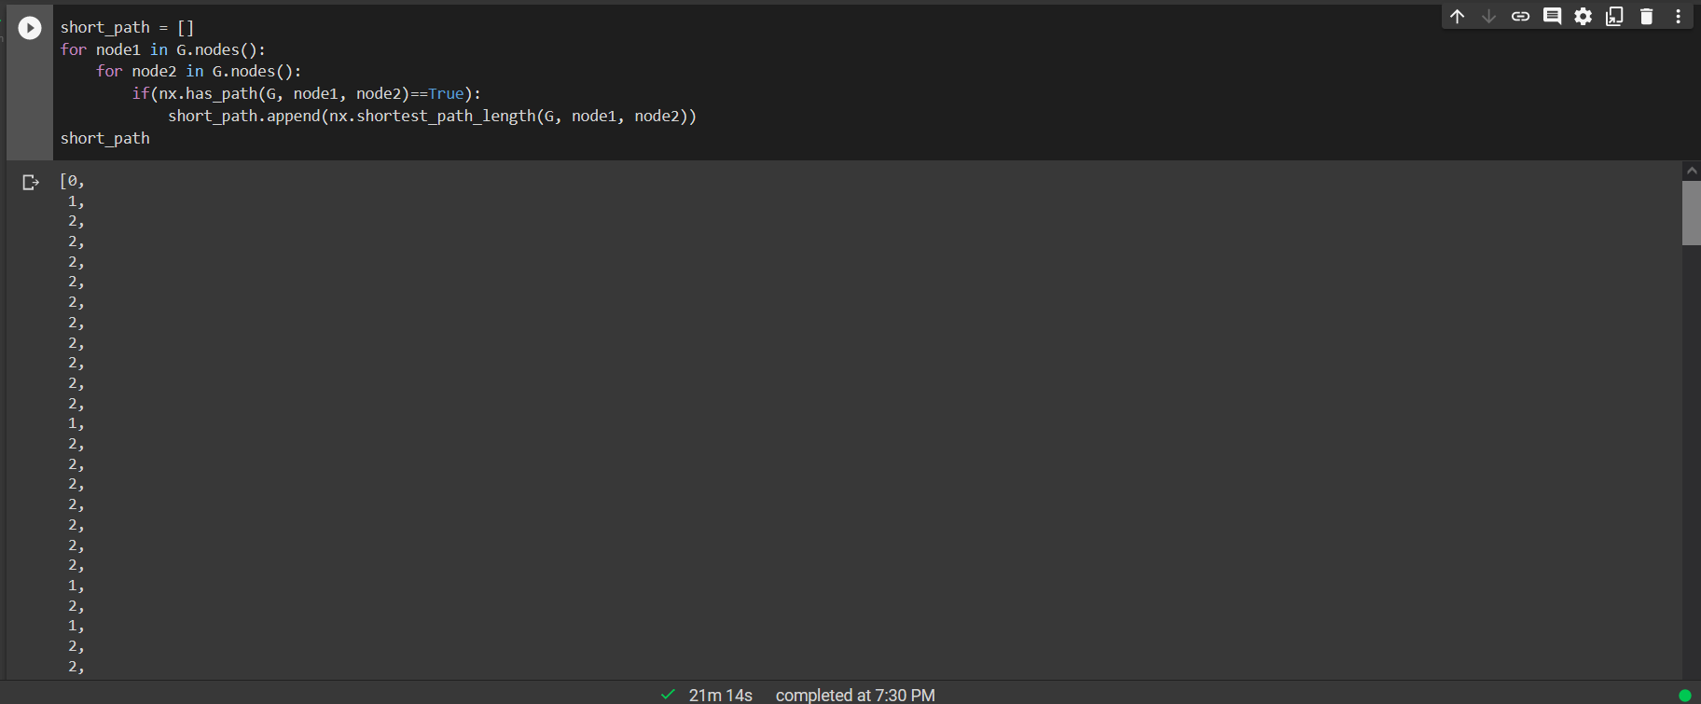
5-Short path between each two nodes

Slide 9
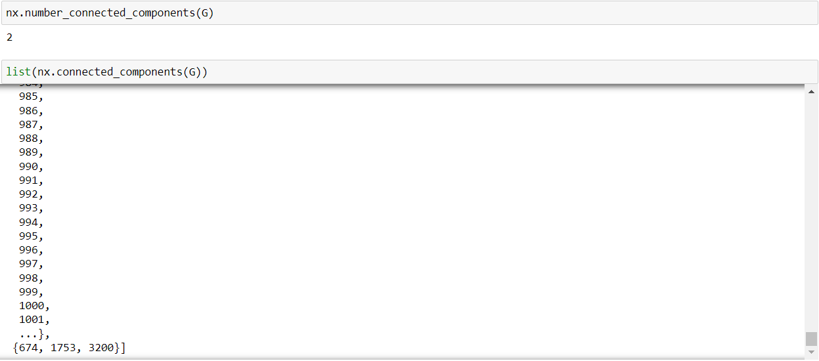
6-number of connected components & list of them

Slide 10
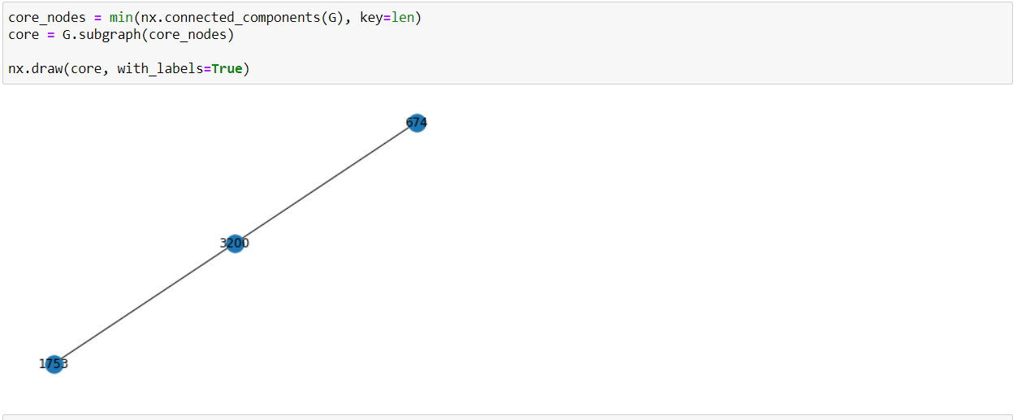
7-Draw one of components

Slide 11
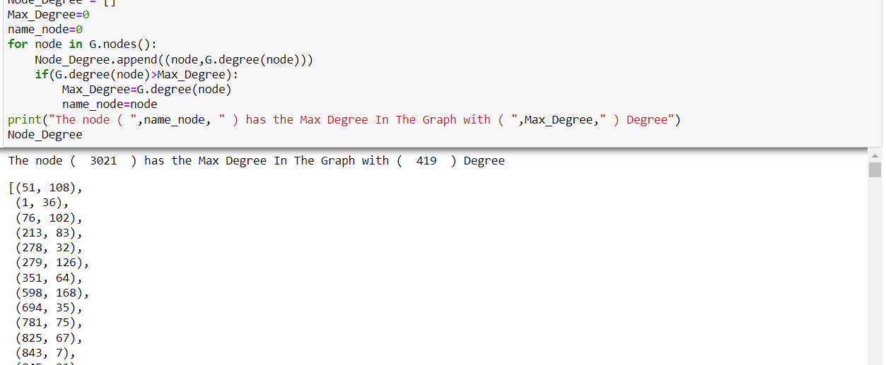
8-node with max degree and all nodes with its degree

Slide 12
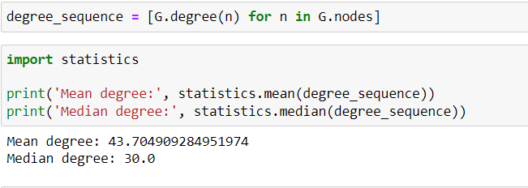
9-Mean & Median for nodes degree

Slide 13
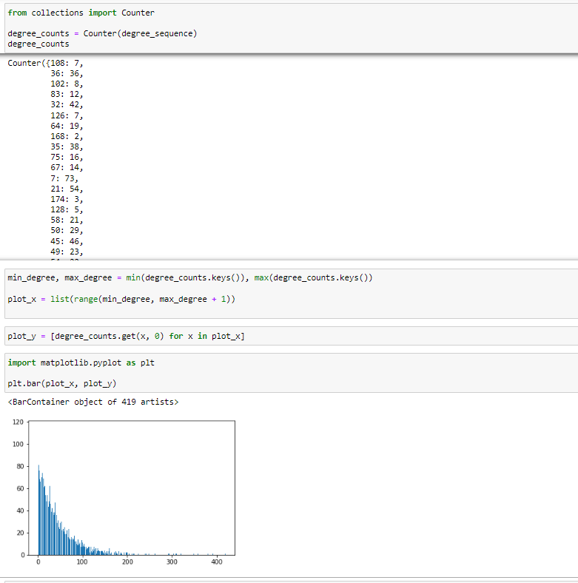
10-Plotting the distribution

Slide 14
Random failure & Targeted attack

Slide 15
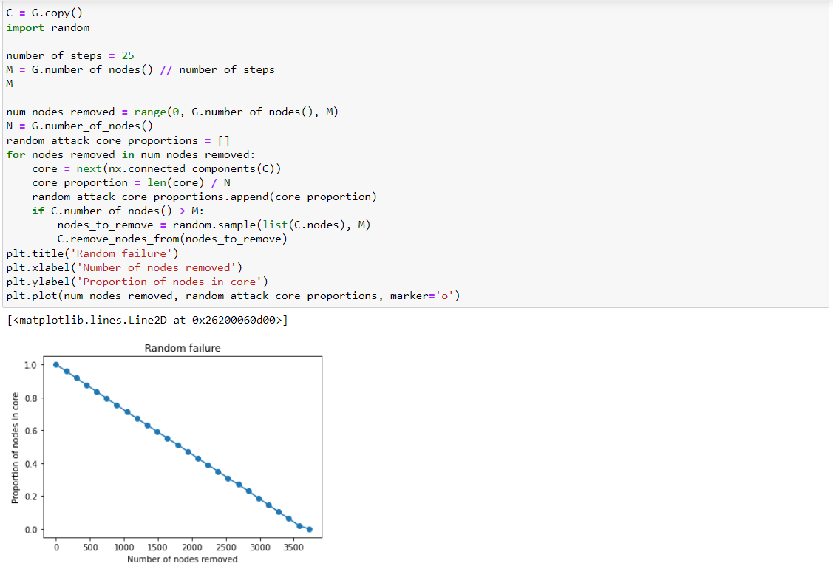
1-Random failure

Slide 16
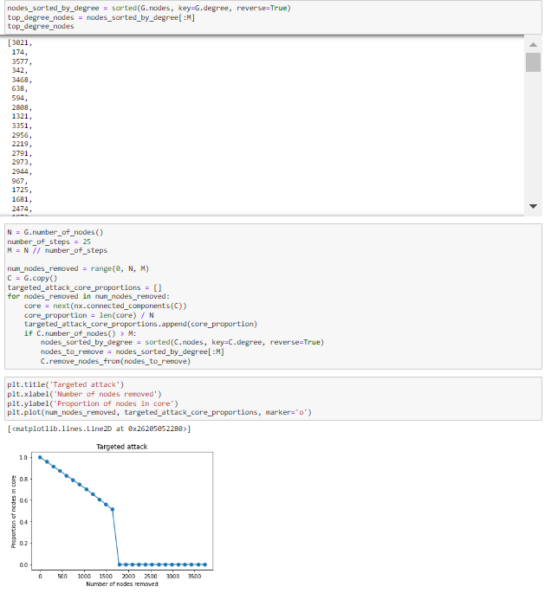
2-Targeted attack

Slide 17
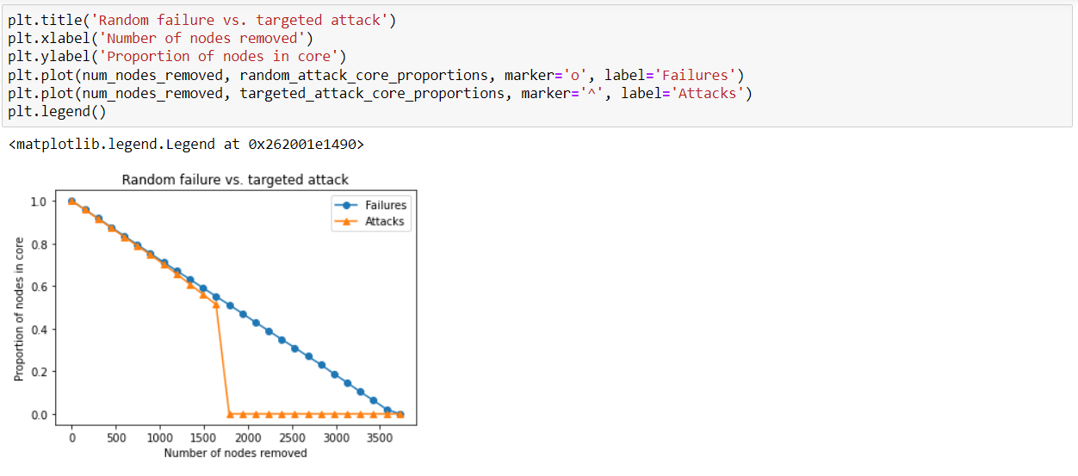
3-Random failure vs Targeted attack

Slide 18
Adjacency Matrix & Degree Distribution

Slide 19
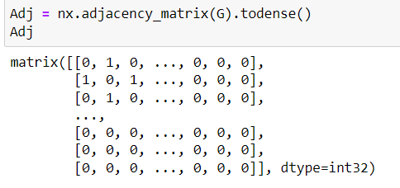
1-Adjacency Matrix

Slide 20
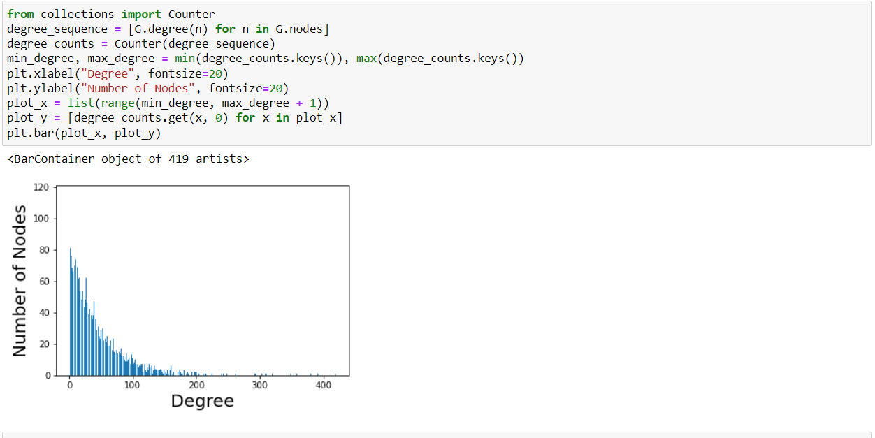
2-degree & number of nodes

Slide 21
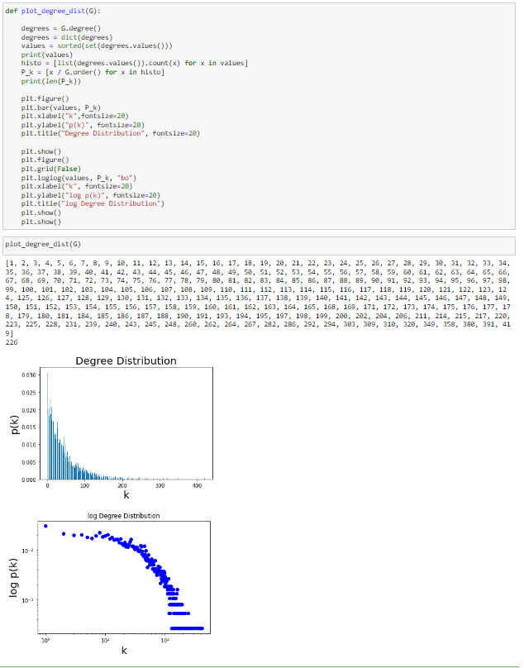
3-Degree Distribution

Slide 22
Community Detection

Slide 23
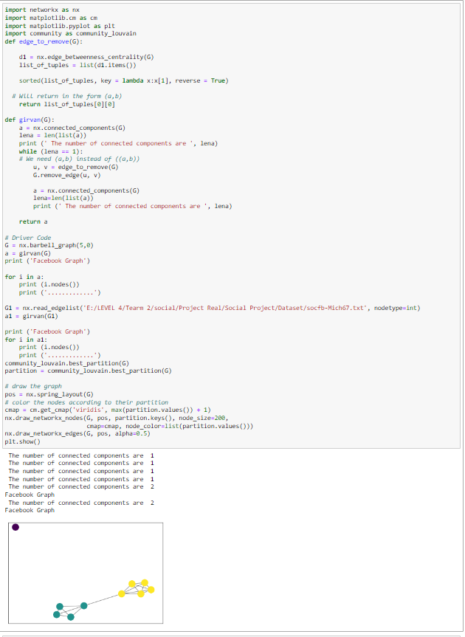
1- community detection

Slide 24
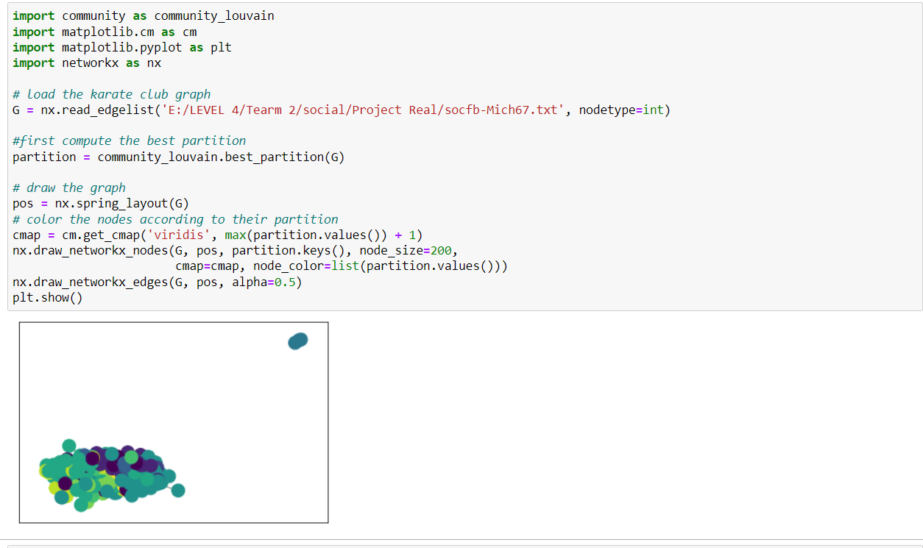
2- community detection

Slide 25
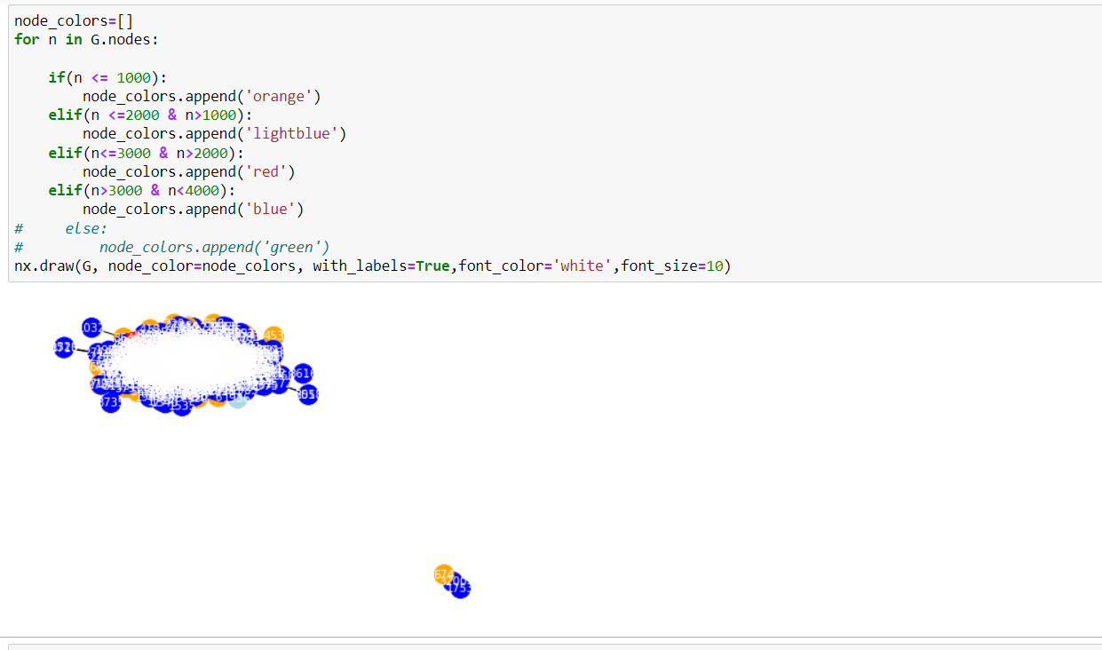
3- Another community detection

Slide 26
Simulation

Slide 27
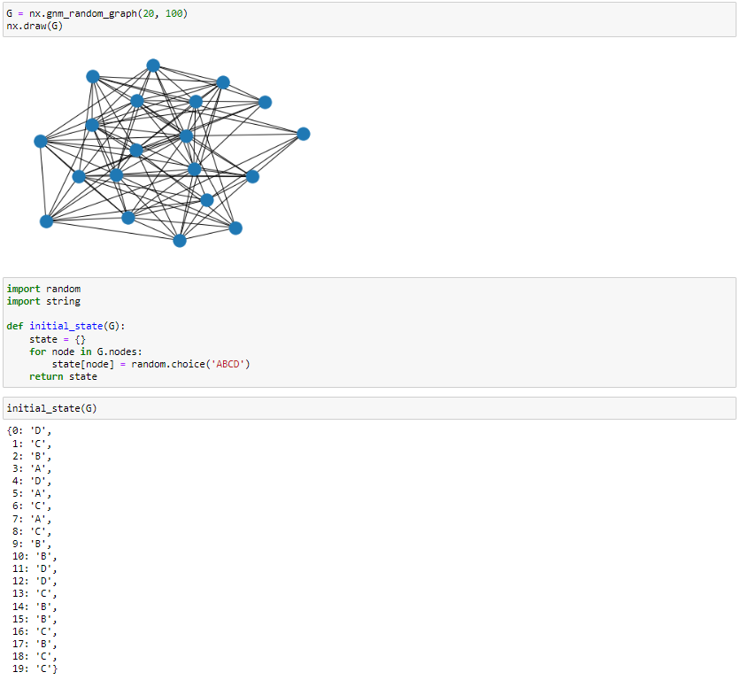
1-random graph with initial state

Slide 28
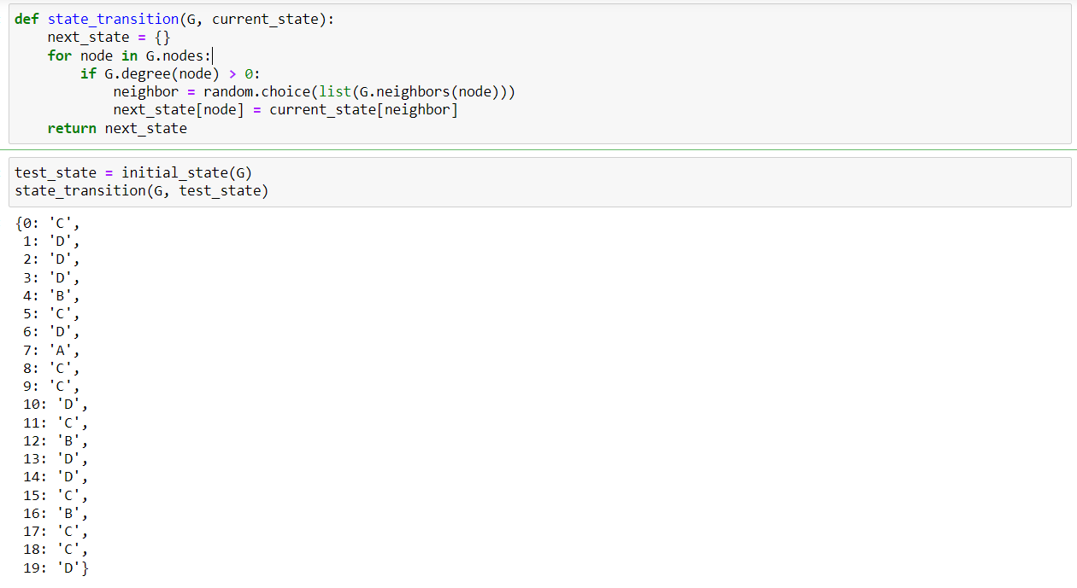
2-make a random state

Slide 29
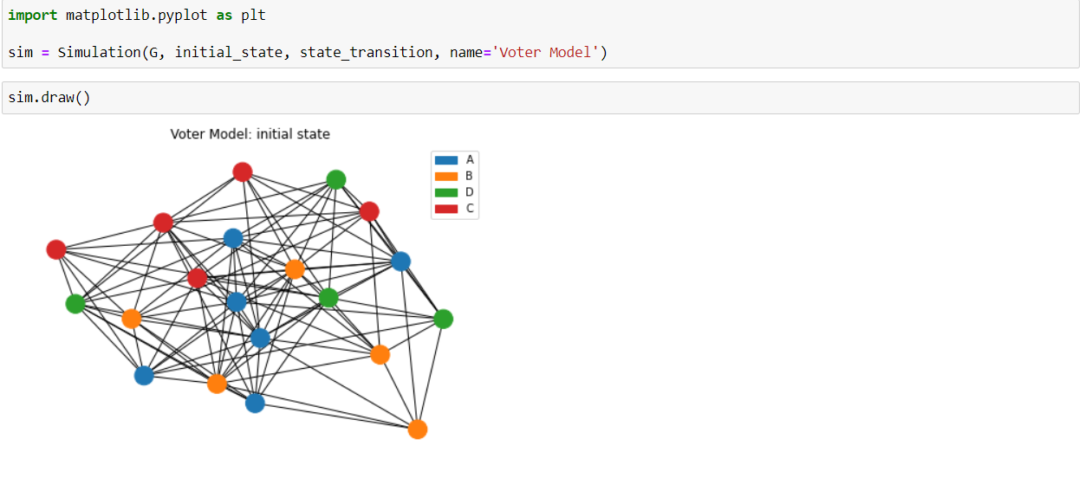
3- Run simulation & result after one step

Slide 30
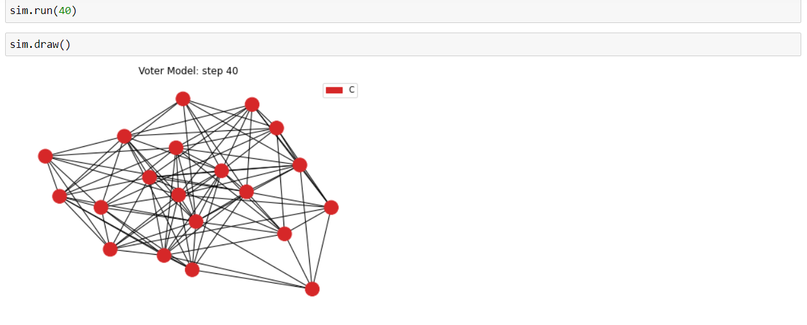
4- Simulation after 41 step

Slide 31
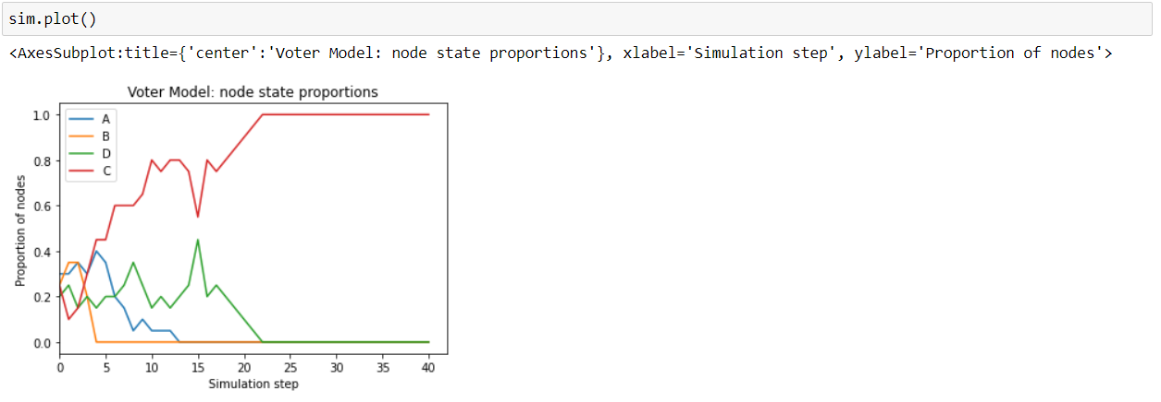
5- plot of simulation result in each step

Slide 32
Code & Files Reference
1- Link For Code :
https://github.com/EL-OMDA-SULTAN/Social_Project.git
2- Link for Files :
https://drive.google.com/drive/folders/1OBVBtwpguci1NyybJ3Uw5C1Tvx8yxMj9?usp=sharing

Slide 33
Thanks For Your Time

